Slide 1
Lecture # 01
Computer Graphics
History and Applications
Dr. Rashed Mustafa
B.Sc. (Engg.) , (SUST), M.Phil (CU), Ph.D. (Shenzhen, China)
Associate Professor
Computer Science and Engineering
University of Chittagong

Slide 2
Course Outline/materials
Outline
Why Computer Graphics

Slide 3
Definition
Computers accept, process, transform and present information.
Computer Graphics involves technology to accept, process, transform and present information in a visual form that also concerns with producing images (or animations) using a computer.

Slide 4
Why Study Computer Graphics?
There are certain important reasons to study computer graphics. We will discuss them under certain heads:
Visualization
  I like to see what I’m doing
  I like to show people what I’m doing
Graphics is interesting
  Involves simulations, algorithms and architecture

Slide 5
History
The term “computer graphics” was coined in 1960 by William Fetter to describe the new design methods that he was developing at Boeing.
He created a series of widely reproduced images on a plotter exploring cockpit design using a 3D model of a human body.

Slide 6
Significance of William Fetter’s Work in 1960:
He created the first known computer-generated images of the human body (often called the “First Man”).
His work laid the groundwork for ergonomics simulation and CAD (Computer-Aided Design).
These graphics were created using plotters, and the data was processed by early mainframe computers.
This was a major turning point where computer graphics moved from purely mathematical/technical representation to visual, design-oriented applications.

Slide 7
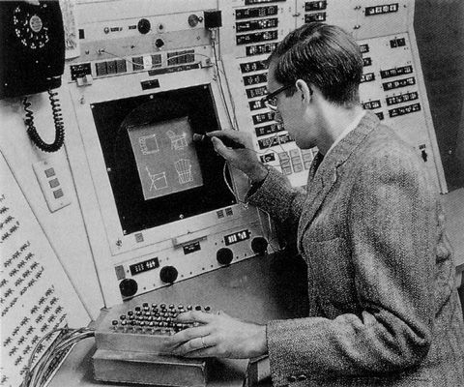
Ivan Sutherland presented sketchpad in 1963

Slide 8
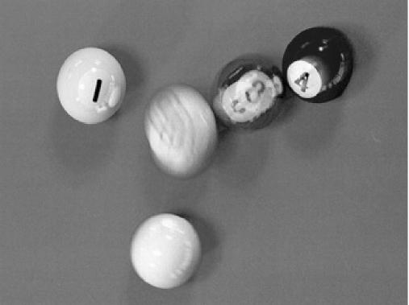
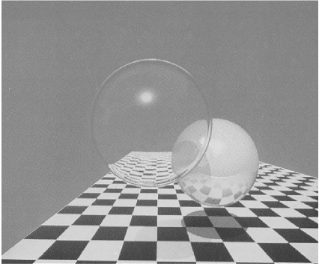
History
First distributed ray traced image(Cook 1984)
First ray traced image (Whitted 1980)

Slide 9
Graphics Applications
Due to rapid growth in the field of computing, now computer is used as an economical and efficient tool for the production of pictures.
Computer graphics applications are found in almost all areas.
Here we will discuss some of the important areas including:

Slide 10
Graphics Applications
User Interfaces
Layout and Design
Scientific Visualization and Analysis
Art and Design
Medicine and Virtual Surgery
Layout Design & Architectural Simulations
History and cultural heritage
Entertainment
Simulations
Games

Slide 11
Scientific Visualization and Analysis
Computer graphics is very helpful in producing graphical representations for scientific visualization and analysis especially in the field of engineering and medicine. It helps a lot in drawing charts and creating models.

Slide 12
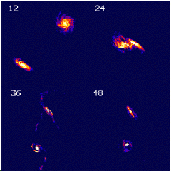
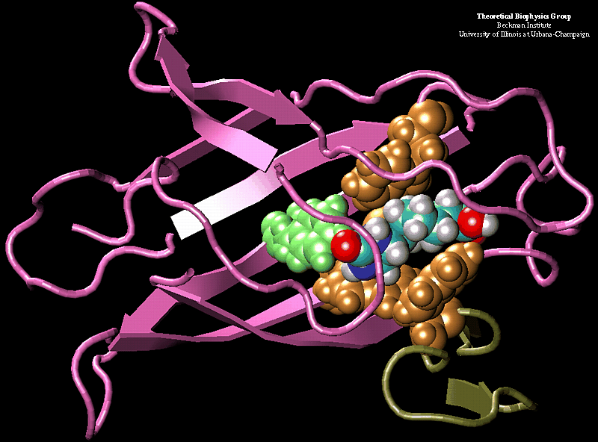
Graphics Applications
Scientific Visualization

Slide 13
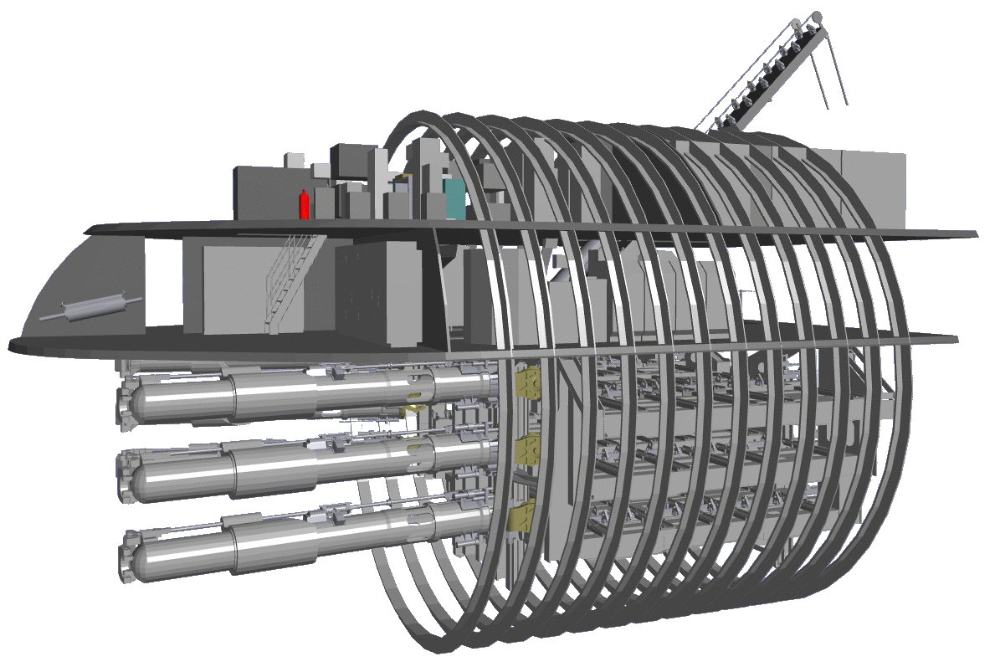
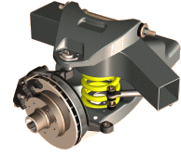
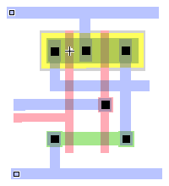
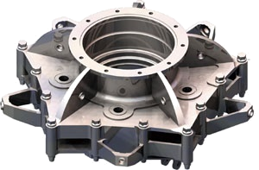
Graphics Applications
Computer Aided Design (CAD)

Slide 14
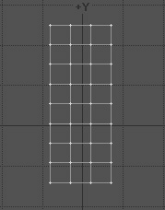

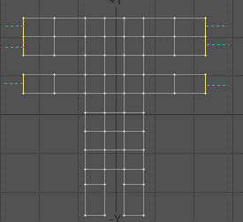
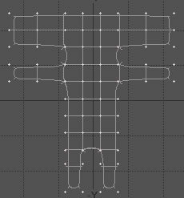
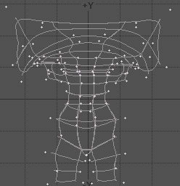
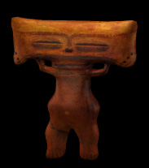
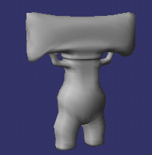
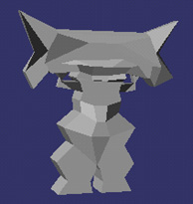
Curve and Surface Modeling in Computer-Aided Design (CAD)
1
2
3
4
5
8
7
6

Slide 15
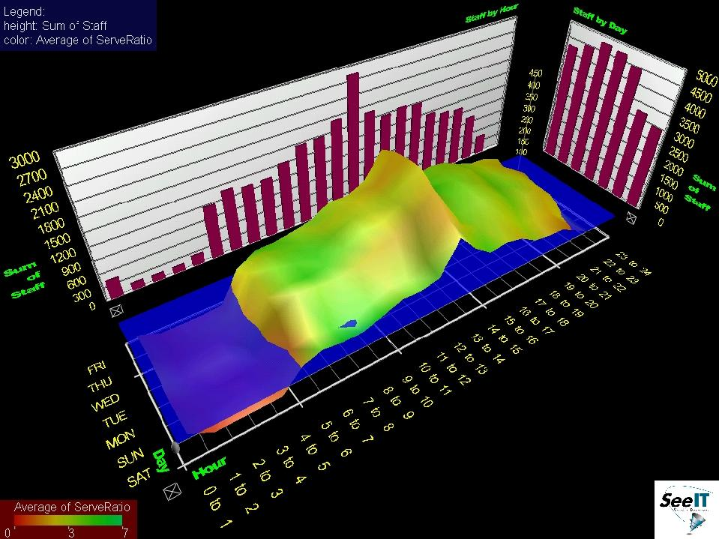
Information Visualization

Slide 16
Art and Design
Computer graphics is widely used in Fine Arts as well as commercial arts for producing better as well as cost effective pictures.
Artists use a variety of programs in their work, provided by computer graphics.
Some of the most frequently used packages include:
  Artist’s paintbrush
  Pixel paint
  Super paint

Slide 17
Medicine and Virtual Surgery
Computer graphics has extensive use in tomography and simulations of operations.
Tomography is the technique that allows cross-sectional views of physiological systems in X-rays photography.
Moreover, recent advancement is to make model and study physical functions to design artificial limbs and even plan and practice surgery.

Slide 18
History and cultural heritage
Another important application of computer graphics is in the field of history and cultural heritage. A lot of work is done in this area to preserve history and cultural heritage. The features so for provide are:
Innovative graphics presentations developed for cultural heritage applications
Interactive computer techniques for education in art history and archeology
New analytical tools designed for art historians
Computer simulations of different classes of artistic media

Slide 19
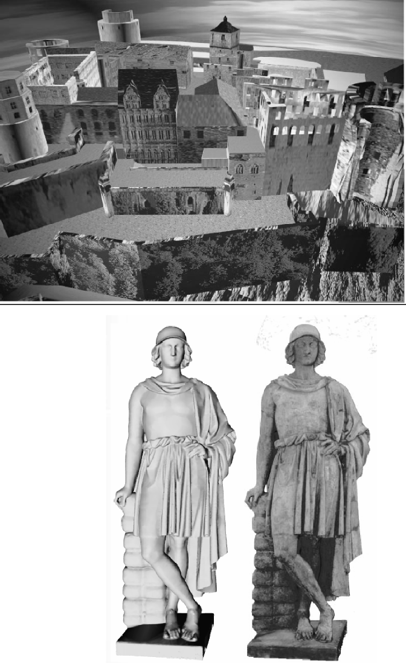
History and cultural heritage

Slide 20
Entertainment
Computer graphics methods are now commonly used in making motions pictures, music videos and television shows.
Sometimes the graphics scenes are displayed by themselves and sometimes graphics objects are combined with the actors and live scenes.
A number of movies and shows are made using computer graphics technology.
Some of them are:
  Star Trek- The Wrath of Khan
  Deep Space Nine
  Stay Tuned
  Reds Dreams
  She’s Mad

Slide 21
Simulation
Simulation by all means is a very helpful tool to show the idea you have or the work you are doing or to see the results of your work.
Given below is the picture in which you can see wave’s ripples on water; no doubt looking like original but is simply a simulation.
A number of software packages are used for simulation including:
  Crackerjack Computer Skills
  Keen Artistic Eye
  Flash
  Maya

Slide 22
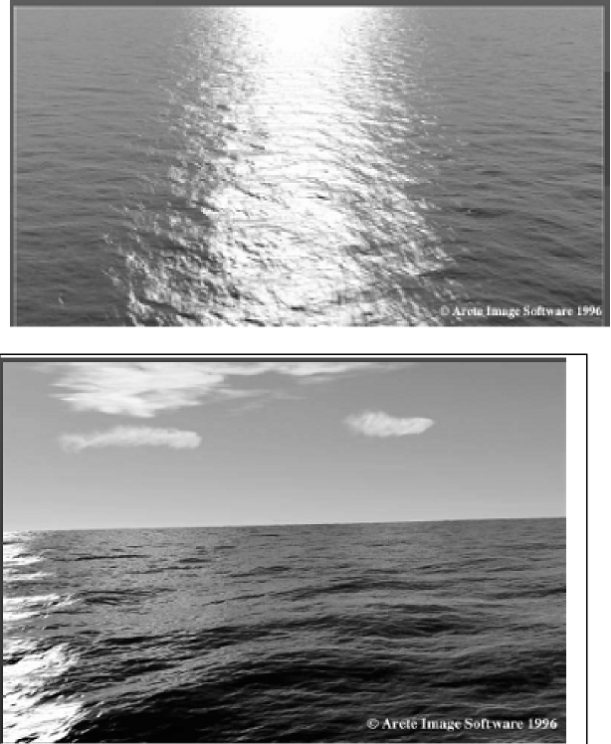
Simulation

Slide 23
Games
Thanks to computer graphics, real time games are now possible. Now game programming itself has become an independent field and game programmers are in high demand.
Some of the famous games are:
• Quake
• Dooms
• Need For Speed
• Commandos

Slide 24
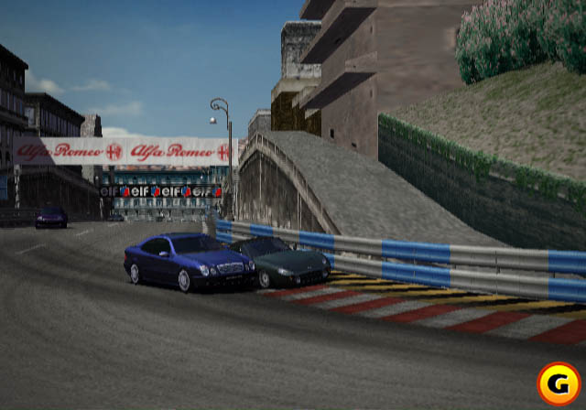
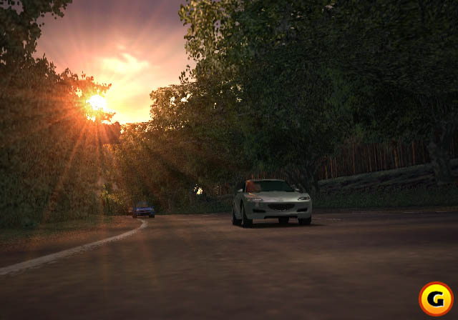
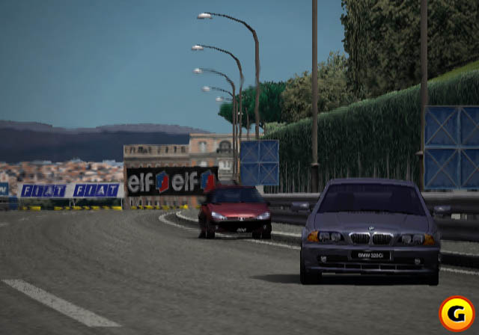
Graphics
Applications
Entertainment: Games

Slide 25
Interdisciplinary
Science
Physics: light, color, appearance, behavior
ƒMathematics: Curves and Surfaces, Geometry and Perspective
ƒEngineering
Hardware: graphics media and processors, input and output devices
ƒSoftware: graphics libraries, window systems
ƒArt, Perception and Esthetics
ƒColor, Composition, Lighting, Realism

Slide 26
Image Synthesis Pipeline
Graphics
Database
Editing
Front-End
(Geometry Processing)
Graphics
Database
Back-End
(Rasterization)
Display
Traversal
Modeling
Transformation
Viewing
Operation
Visible-Surface
Determination
Scan Conversion
Shading /
Illumination
Image

